Slide 1

Investigating the Social World
Week One. Margarita Aragon

Slide 2
In this lecture...
Introductions to the module
Social science and coloniality
the quest for objectivity: value, subjectivity and reflexivity

Slide 3
Module overview
in this module we will:
introduce and evaluate different approaches to social inquiry, assessing the differences and commonalities between them
think carefully about the social and political issues at stake in knowledge production
think about how particular theoretical frameworks underpin the practice of social research.

Slide 4
some key questions:
These questions are not settled! But thinking about them will help you to develop your own research and to evaluate the research of others!
In this module: read critically and inquisitively
How do we produce valid and useful knowledge about the social world?
Under what social and political conditions is knowledge produced?
What is the relationship of the knowledge producer to the worlds they make claims about?
Why do we do research? What are our responsibilities?

Slide 5
Introductions
Tell us your name, your programme and something interesting about you...

Slide 6
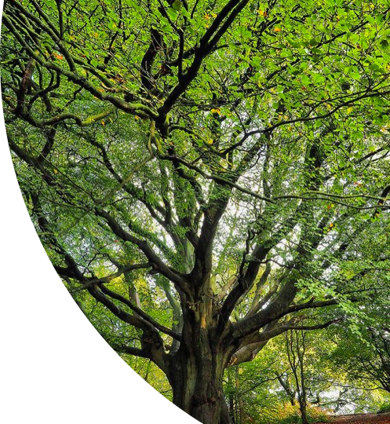
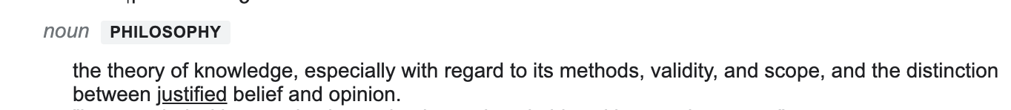
Epistemology
What do we know? How do we know what we know? How is knowledge justified?
Related to these questions is another set of questions, that we need to examine in historical context:
How is knowledge recognised as knowledge (institutionally, politically etc)?
Where is knowledge seen to be located (in which bodies and spaces)?
Whose knowledge counts?

Slide 7
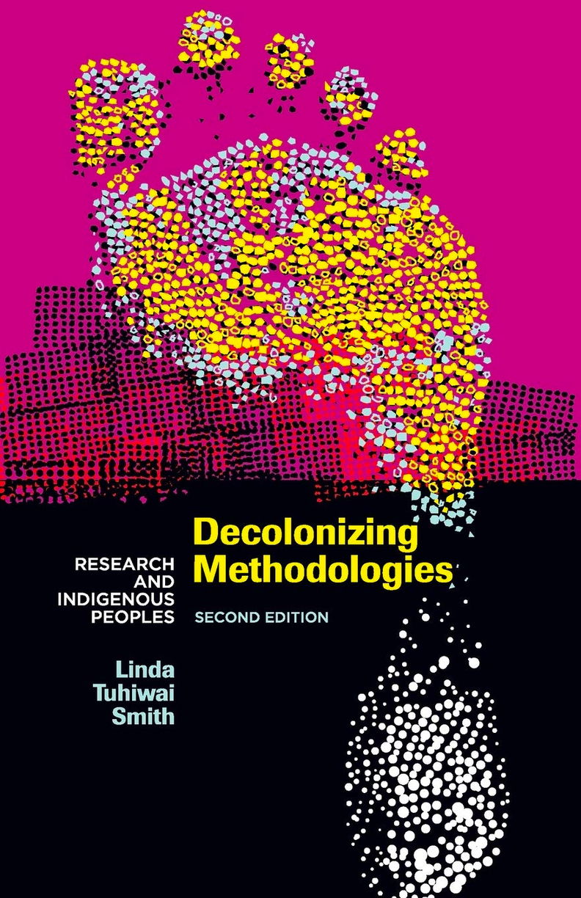
An archive of knowledge
'Western research draws from an "archive" of knowledge and systems'-
'a cultural orientation, a set of values that imposes its own conceptualization of such things as time and space and subjectivity... theories of knowledge, highly specialized forms of language and structures of power.'
Power is expressed at both the explicit and implicit levels.
production of knowledge has material consequences - 'Ideas about these things help determine what counts as real.'

Slide 8
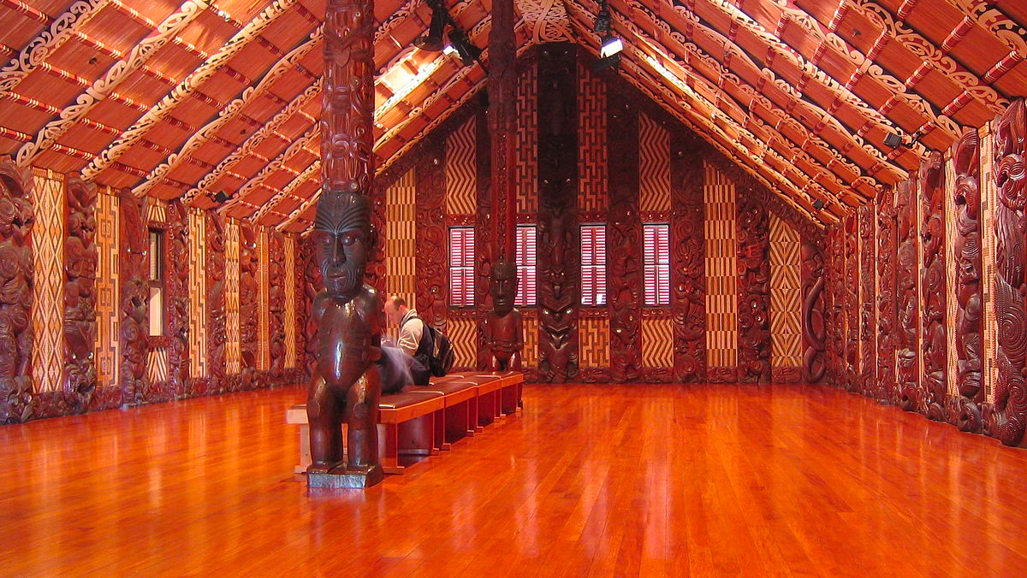
Mataatua: The house that came home
Transformed into an object of colonial knowledge
'It changed from being a "living" meeting house which the people used and had become an ethnological curiosity for strange people to look at the wrong way and in the wrong place.'

Slide 9
Research 'through imperial eyes'
'Research "through imperial eyes" describes an approach which assumes that Western ideas about the most fundamental things are the only ideas possible to hold, certainly the only rational ideas, and the only ideas which can make sense of the world, of reality, of social life and of human beings.'
'It is research which is imbued with an "attitude" and a "spirit" which assumes a certain ownership of the entire world, and which has established systems and forms of governance which embed that attitude in institutional practices.'
why is this relevant for us here and now?
how might such an attitude imbue knowledge production in other contexts?

Slide 10
Science and objectivity
‘Scientific knowledge is reliable knowledge because it is objectively proven knowledge… [It is] derived in some rigorous way from the facts of experience acquired by observation and experiment. Science is based on what we can see, hear, and touch, etc. Personal opinion or preferences and speculative imaginings have no place in science. Science is objective’ (Chalmers 1982, 1).

Slide 11
a) Facts are directly given to careful, unprejudiced observers via the senses.
(b) Facts are prior "to and independent of theory-
(c) Facts constitute a firm and reliable foundation for scientific knowledge.
Before an observer can formulate and assent to an observation statement, he or she must be in possession of the appropriate conceptual framework and a knowledge of how to appropriately apply it.
the judgment of the truth or otherwise of an observation statement depends on the knowledge that forms the background against which the judgment is made

Slide 12
Science and objectivity
‘Scientific knowledge is reliable knowledge because it is objectively proven knowledge… [It is] derived in some rigorous way from the facts of experience acquired by observation and experiment. Science is based on what we can see, hear, and touch, etc. Personal opinion or preferences and speculative imaginings have no place in science. Science is objective’ (Chalmers 1982, 1).
'[S]cientific beliefs, practices, institutions, histories, and problematics are constituted in and through contemporary political and social projects, and always have been' (Harding 1991)

Slide 13
Facts and values
Many early social scientists took the position that scientific knowledge of social phenomena should be pursued by adapting the method and logic of natural science- social facts that can be objectively measured
How can social science maintain scientific validity when its object of study is human behaviours and beliefs? (See Montuschi 2014)
An example to consider: In 1998 the Minister of Health in the Netherlands undertook a randomly controlled experiment to understand why some heroin users didn't respond to methadone, promoted as 'impartial, unambiguous and 'the best route to discover the truth"'
'The design pre-ordered the reality of drug abuse into categories and classifications purposefully chosen to meet the requirements of the experiment...the experiment could only represent the reality allowed by the constraints of its own design.' (139-149)

Slide 14
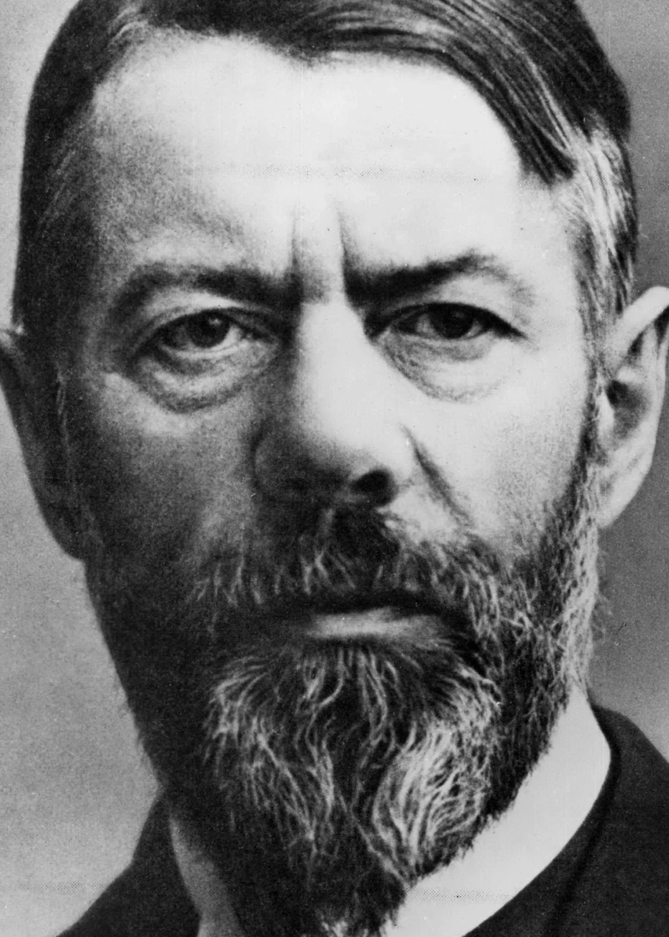
'Value free' inquiry
Weber- differentiates 'value relevance' and 'value judgement.'
Cultural and social values are areas for investigation. They determine what is relevant to study.
Value judgements are subjective evaluations, ideals, etc that social scientists should avoid when they make claims (Montuschi 2014, 129)
‘Passionate detachment’- hard work and enthusiasm, but – ‘One should neither preach one's religion nor impose one's politics on a captive audience.’
Ideal of detachment in social science demands researcher remove bias by ‘becoming the emotional, cognitive, and moral equivalent of a blank slate’ (Rosaldo 1993)
Max Weber

Slide 15
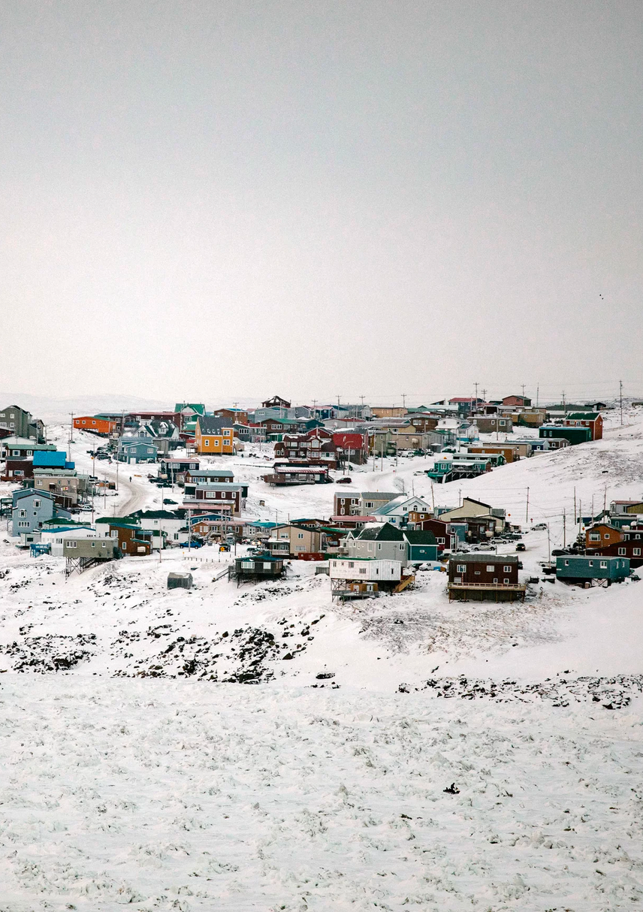
Disrupting 'masculine heroics'
‘Suddenly, something in me gave up. I had no will to struggle further. Dropping to my knees and lowering my head to the ice, I crawled toward home, seething with humiliation and rage but totally unable to stand up. Shielded by the parka and hood that fell over my face, I wept at my ignominy.’
(Briggs in Rosaldo 1993, 177-179)
Iqaluit, where Briggs did her fieldwork.
Photo by Johan Hallberg-Campbell for NPR

Slide 16
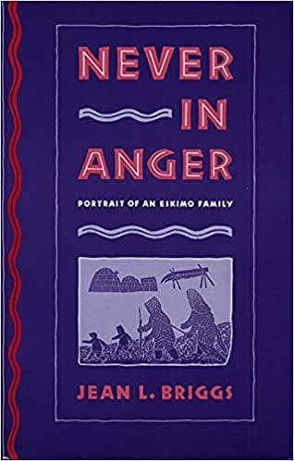
'Lesser' sources of knowledge
Briggs’s own depression and her hosts’ response to it becomes central to Never in Anger. They become sources of insight into the cultural configuration of emotion
'Passionate detachment’ too ‘severely restricts the legitimate sources of knowledge for social analysis. Feebleness, depression, rage, anxiety can be sources of knowledge.' (Rosaldo 1993, 177-17
What do you think about this position?

Slide 17
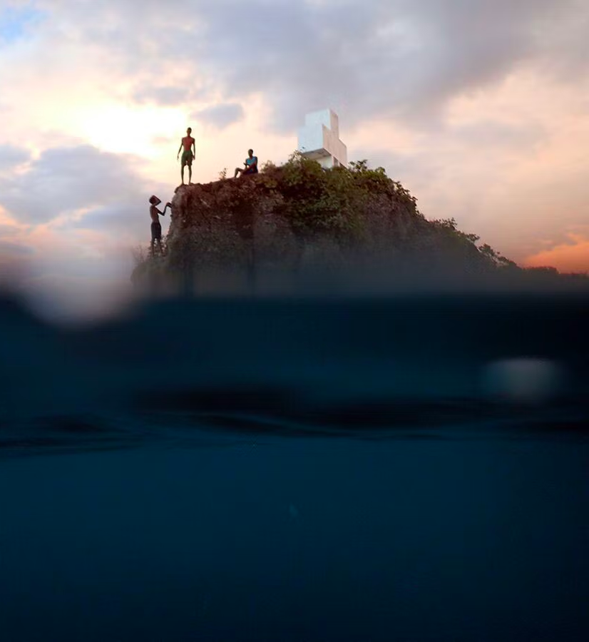
being somewhere in particular
Science has often employed 'the conquering gaze from nowhere’ - claims the power to see not be seen, to represent while escaping representation (Haraway 1988, 581).
The only way to find a larger vision is to be somewhere in particular’ (590).
Reflexivity: Making visible the practice and construction of knowledge within research in order to produce more accurate analyses' (Pillow 2003, 178)
photo by Nadia Huggins,

Slide 18
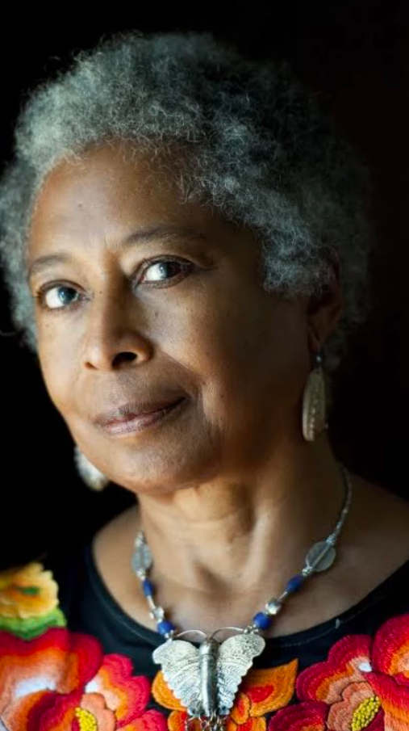
Connections and partial claims
Against a 'the god trick' of 'seeing everything from nowhere':
I am arguing for a view from a body, always complex, contradictory, structuring and structured body, versus the view from above, from nowhere, from simplicity (Harraway 1988, 589).
“What is always needed in the appreciation of art, or life is the larger perspective. Connections made, or at least attempted, where none existed before, the straining to encompass in one’s glance at the varied world the common thread, the unifying theme through immense diversity”. (Alice Walker in Hill Collins 270)
Alice Walker

Slide 19
what is the point?
The point is to make a difference in the world, to cast our lot for some ways of life and not others. To do that, one must be in the action, be finite and dirty, not transcendent and clean (Haraway 1997, 36)

Slide 20
Discussion
Reflecting on the lecture and the reading:
What do you think of these arguments making visible construction/practice of knowledge can produce knowledge that is more valid?
Should research be about changing the world rather than just describing it? In some cases? All cases? What potential issues might be involved from either position?

